Slide 1

HOUSING PRICE PREDICTION
Internship presentation
Under supervision:
Shubhum Yadav
Submitted By:
Akanksha Srivastava

Slide 2
Introduction Analytic Problem farming Model Development / Evaluation Conclusion
TABLE OF CONTENT

Slide 3
INTRODUCTION
House Price prediction is commonly used to estimate the changes in housing price. Since housing price is strongly correlated to other factors such as location, area, population.
Everybody needs a roof over their heads. It can be a house, a villa, or a flat. Everybody, at some point in life, faces a choice whether to buy a house. Houses are one of the necessary needs of each and every person around the globe and therefore housing and real estate market is one of the markets which is one of the major contributors in the world’s economy.
The major things customer taking care of these matter:
Property Price
Flat’s Carpet Area
Land Record
Legal Check of Property
Apartment Possession
Financing Banks
Builder-Buyer Agreement
Location of the Flat
Hidden and Additional Charges

Slide 4
ANALYTICAL PROBLEM FRAMING
EDA
DATA PREPROCESSING
DATA INPUTS-LOGIC-OUTPUT RELATIONSHIP
MODEL DEVLOPMENT AND EVALUATION

Slide 5

EDA
Handling Null Values
Analysis the categorical Data
Univariant analysis
Bai Variant Analysis
Multi variant Analysis
Skewness
Outlier

Slide 6
DATA PREPROCESSING
Label encoder(Encoding the categorical data into numeric)
Removing Outlier(removing the Outlier With IQR(Hyper Tunning))
Split The Data Data into Test And Train
Removing The Skewness
Scaling The Data
PCA

Slide 7
DATA INPUTS-LOGIC-OUTPUT RELATIONSHIP
Here we know That Our Target Variable is Continues.
so we are going to use the below metrics
R2 Score
MSE-Mean Square Error
MAE-Mean Absolute Error
RMSE-Root Mean Square Error

Slide 8
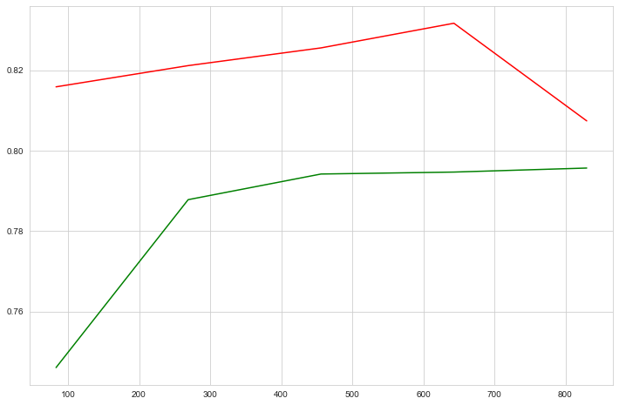
ALGORITHMS
Linear Regression
Training vs Testing

Slide 9
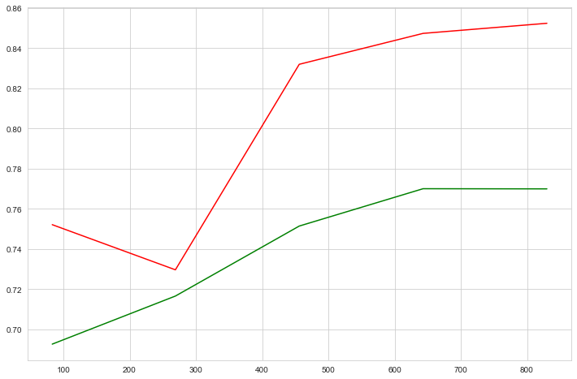
ALGORITHMS
KNeighborsRegressor
Training vs Testing

Slide 10
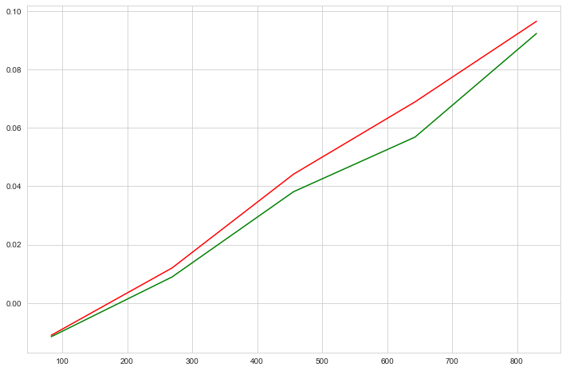
ALGORITHMS
SVR
Training vs Testing

Slide 11

ALGORITHMS
Lasso
Training vs Testing

Slide 12
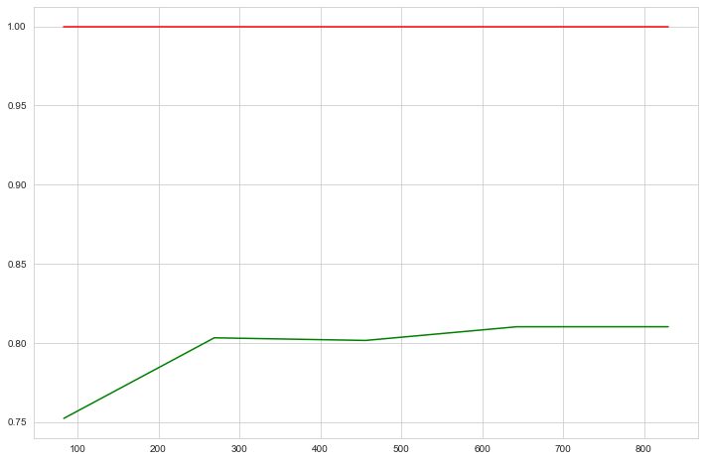
ALGORITHMS
ExtraTreesRegressor
Training vs Testing

Slide 13
Here we are getting the Highest accuracy with Extra tree Regressor we are going to save the model with this.

Slide 14
CONCLUSION
Over All Quality is most important to get the better sales price if the business need more sales price similarly they should be increase there Quality. And They Should Maintain the Same.

Slide 15
Thank you

